Slide 1
A Probabilistic Graphical Model for Brand Reputation Assessment in Social Networks
Kunpeng Zhang, Yu Cheng, Yusheng Xie,
Doug Downey, Ankit Agrawal, Alok Choudhary
{kzh980,ych133, yxi389,
ddowney,ankitag,choudhar}@eecs.northwestern.edu

Slide 2


Acknowledgement

Slide 3
Outline
Introduction
Problem Definition
Methodology
Social Sentiment Identification
Proposed Graphical Model
Experimental Results
Related Work
Future Work

Slide 4





Introduction
Social media data
Mining social data to make informed decisions is helpful for individuals and business companies.
User opinions from reviews, blogs, comments, etc.
Marketing analysis, competitor analysis.
Brand reputation
…

Slide 5
Challenges
Understanding user opinions (positive, negative, objective)
Social sentiment identification
Bias on users’ opinions
How do we reduce biases and fairly evaluate a social brand?
Big data
How do we efficiently measure brand reputation?

Slide 6
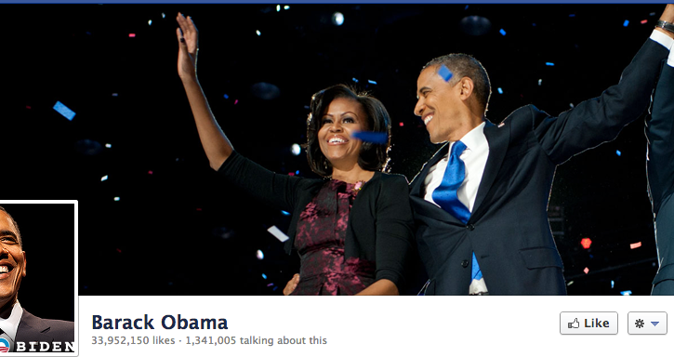
An Example Facebook Page
Number of fans

Slide 7
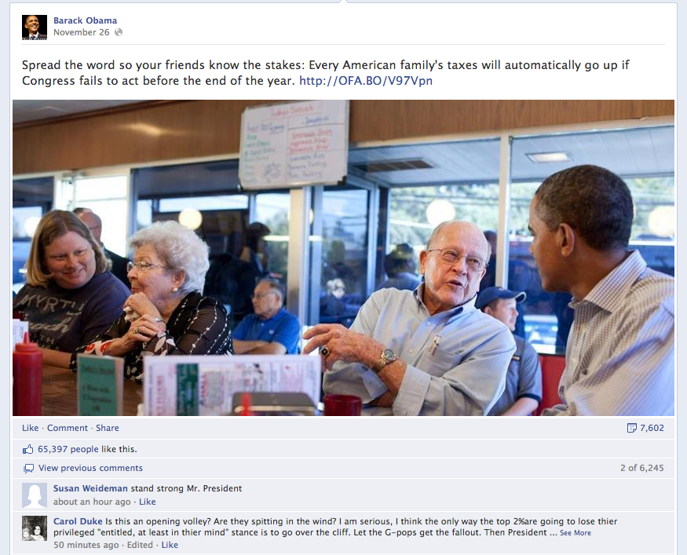
Post
Comment
Post Like

Slide 8
Statements
Each user can make comments or like multiple posts on different pages.
Each page can receive comments or likes from different users.
User can make positive, negative, or objective comments.
How do we make use of these networked information, textual information to infer reputation of social brands with reducing bias?

Slide 9
Sentiment Identification*
Ensemble method
Extended compositional semantic rules
12 semantic rules and 2 compose functions
One example of rules: If a sentence contains the key word “but”, then consider only the sentiment of the “but” clause.
Frequency-based method
The strength of a sentiment is expressed by the adjective and adverb used in the sentence.
Adverb-Adjective-Noun (abbreviated as AAN) and Verb-Adverb (VA).
Bag-of-word method
Positive/negative/negation word list
Internet language
emoticons
Domain-specific words
*: previous work at ICDM2011, SIGIR2012

Slide 10
Problem Statement
S₁₁
P(R₁)
R₁
U₁
U_{i}: user i
R_{j}: brand j
S_{ij}: sentiment of comments made by user U_{i} on brand R_{j}
S₂₁
P(R2)
R₂
U₂
S₃₂
Given large amounts of user activities (comments) in social networks, we want to infer the brand reputation.
P(R₃)
R₃
U₃
S₂₃
…
…
…
…
P(R_{m})
R_{m}
U_{n}
S_{nm}

Slide 11
Observations
Different people have different positivity.
(e.g., star ratings on Amazon.com)
Positive people are likely to give positive comments to brands with high reputation.
Sentiments of comments can be “observed”.
(We have the state-of-the-art techniques to identify sentiments.)

Slide 12
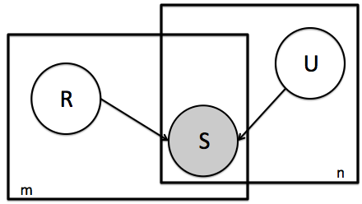
The Probabilistic Graphical Model
S: observed variable
R, U: hidden variables
All variables have binary values
m: number of brands
n: number of users

Slide 13
Collective Inference
The goal is to infer all P(R).
Intractable:
Difficult to calculate the partition function (denominator) due to a large discrete state space.
Millions of users, Billions of comments

Slide 14
Gibbs Sampling (MCMC)
Brand reputation

Slide 15
Gibbs Sampling (MCMC)
User positivity

Slide 16
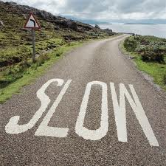

Slide 17
Important Observations: Conditional Independency
R₁ , R₂ , · · · , R_{m} are independent of each other given all U₁, U₂, · · · , U_{n} and all observed variables S_{ij}.
Similarly for all U’s.

Slide 18
Parallelized Block-based MCMC
Consider users and brands as two separate blocks.
We alternately sample all R_{i} and U_{j} in each sampling round.
Can be scalable to solve problems with big size by parallelizing within each block.

Slide 19
Parallelized Block-based MCMC
Block 1
Block 2
S₁₁
R₁
U₁
S₂₁
R₂
U₂
S₃₂
R₃
U₃
S₂₃
…
…
…
R_{m}
U_{n}
S_{nm}

Slide 20
Experimental Data
Facebook data
Also applicable to other platforms.
Facebook Graph API
11,140 brand pages and 270M users by May 1, 2012.

Slide 21
Data Cleaning
Remove pages whose major language are not English;
Ignore pages receiving very few comments (<=10000);
Filter out spam users;
Ignore users who make comments on only 1 brand (<=2);
Ignore users who make very few total comments across all brands (<= 5).
Data Stats
# of unique users | 15,528,173
# of social brands | 7,523
# of comments | 126,613,072
# of positive comments | 93,233,898
# of total posts | 8,186,454

Slide 22
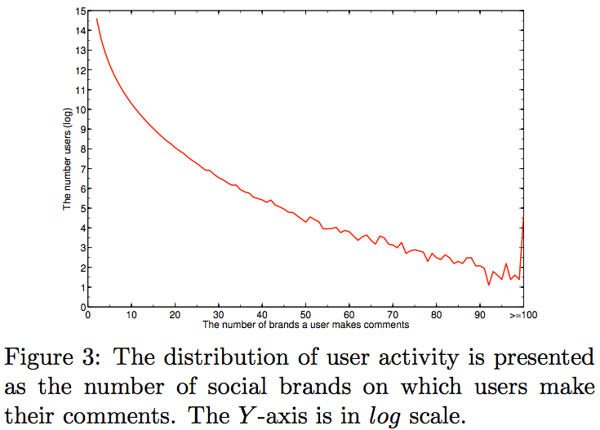
Spam Users
On average, a user comments on 4 to 5 brands.
We set the threshold of 100 to discard users making comments on more than 100 brands.

Slide 23
Evaluation (1)
Converges of the parallelized blocked-based MCMC
X-axis: sampling
round
Y-axis: reputation
probability

Slide 24
Evaluation (2)
How efficient is the parallelized block-based MCMC?
Speedup
X-axis: sampling
round
Y-axis: speedup S_{p}
P = 8

Slide 25

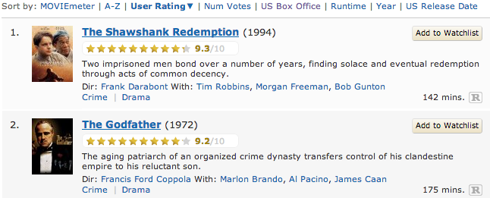
Model Evaluation
Existing IMDb movie ranking
(Internet Movie Database)

Slide 26
Model Evaluation
Rank correlation (spearman correlation) between our reputation and IMDb index (rating score, votes, box revenue)
Our reputation VS. IMDb rating score | 0.757
Our reputation VS. the number of votes in IMDb | 0.440
Our reputation VS. the box office revenue in IMDb | 0.283

Slide 27

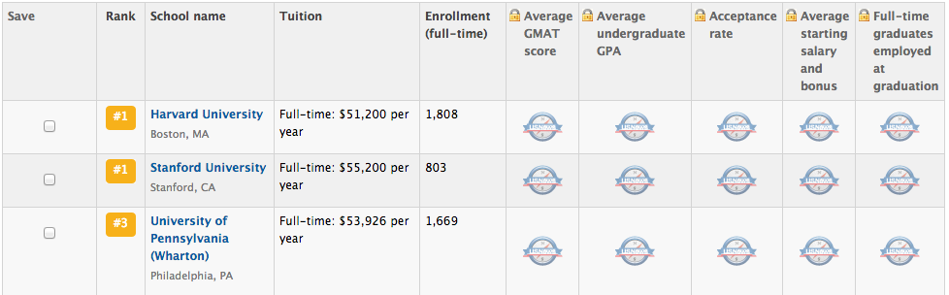
Model Evaluation
Business school ranking from US News & World Report

Slide 28
Model Evaluation
Rank correlation (spearman correlation) between our reputation and business school ranking from US News & Word Report
Our reputation VS. top business school ranking from US News & World Report | 0.715

Slide 29
Not significant

Slide 30
Learning Models Based on All Those Metrics
Least absolute deviation, Poisson regression, logistic regression, and SVM regression.
Features: All listed metrics in the above slide.
Train on movie data.
Test on business school data.
Rank correlation between predict values and existing values
The best we obtained is 0.52 through SVM regression.

Slide 31
Parameter Setting
Gama (γ) is the threshold for positive vs. non-positive sentiment.

Slide 32
Future Work
Incorporating more factors to make model more comprehensive.
Integration data from other social platform such as twitter, Google+, LinkedIn, etc. to make inference more reliable.

Slide 33
Related Work
Behavior targeting
Learning from past user behaviors, especially feedbacks (i.e., comments, clicks) to match the best advertisements to users. [Chen; Kumar]
Recommender systems
[Han, et al] proposed a network-based refinement approach utilizing the patent information network for prediction, smoothing and optimization.
Sentiment analysis
From rule-based, bag-of-words approaches to machine learning techniques which classifies as positive or negative. [Pang, et al]

Slide 34

Questions?

